Slide 1
Olist Store Analysis
Group - 4

Slide 2
Team Members
Onkar Jegarkallu
Sameer Gokhale
Sanskruti Gavand
Krushnapriya Bodhankar
Bhagyashri Ghonmode

Slide 3
Introduction & Business Objective
Introduction:
The Olist Store Analysis project aims to analyze customer purchasing patterns and payment statistics on an E- commerce platform, Olist.
Objective:
The objective of the project is to create several kpi’s and create a dashboard to analyze the olist store based on the available data.

Slide 4
Project Flow
Raw Data
Data Cleaning, Sorting
Excel Dashboard
Create KPI’s
Tableau Dashboard
SQL-Queries
PowerBi Dashboard

Slide 5
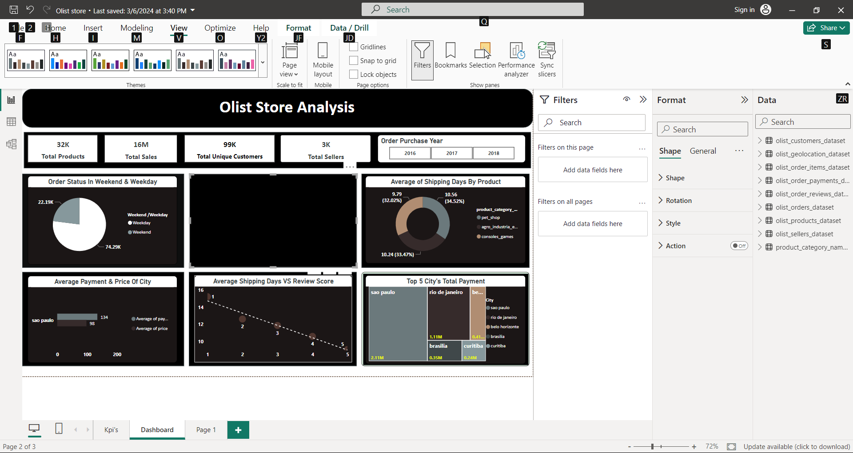
KPI 1: Weekday Vs Weekend payment statistics
From the graph it is very evident that weekdays seems to days where the business is best.
The pattern showcases that maximum people offer shopping on weekdays instead of weekend.
Order share on weekdays:74.29K
Order share on weekends:22.19k

Slide 6
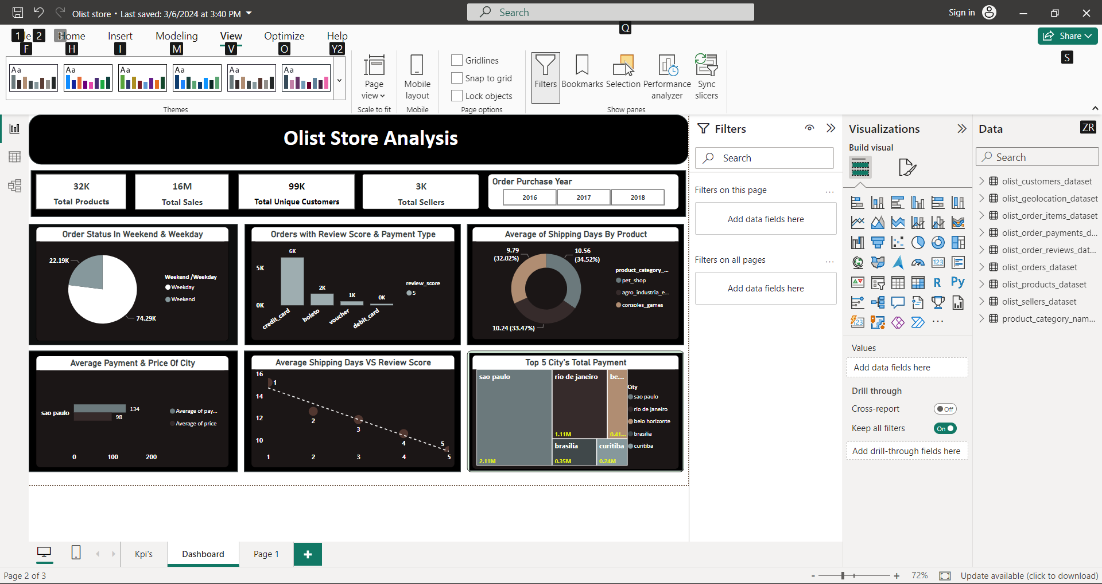
KPI2: Number of Orders with review score 5 and payment type as Credit card
With a review score of 5 and payment type as a credit card, We received 6K orders.
More orders have been placed via Credit card payment than Boleto, Voucher, and Debit card.
Credit cards are the most preferred mode of payment in market.
Businesses should encourage the use of credit cards to increase the number of sales by certain amount of discounts or no-cost EMI’s on credit card payments.

Slide 7
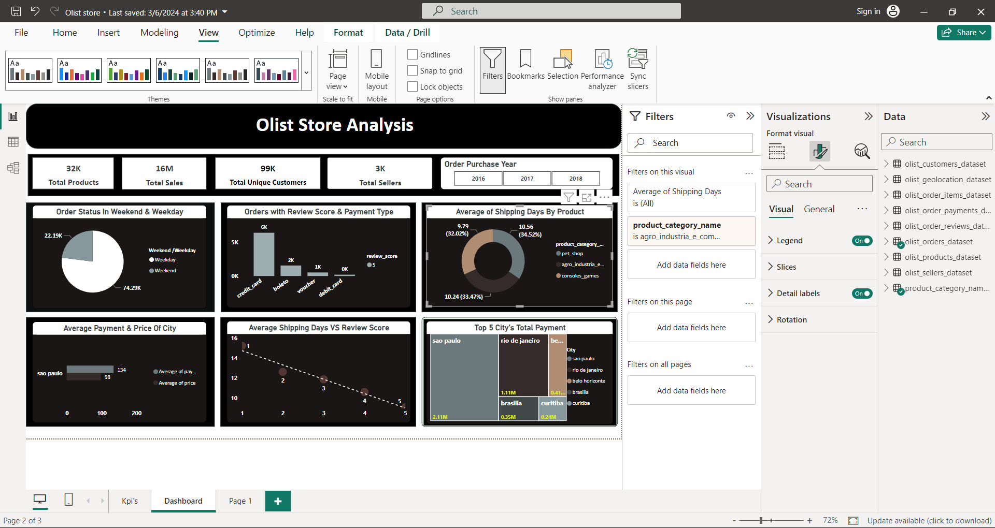
KPI 3:Average number of days taken for order delivered for pet shop
This KPI analyzes the average number of days taken for order_delivered_customer_date for pet_shop. It helps Olist in identifying areas where they can improve their delivery time and maintain customer satisfaction.

Slide 8
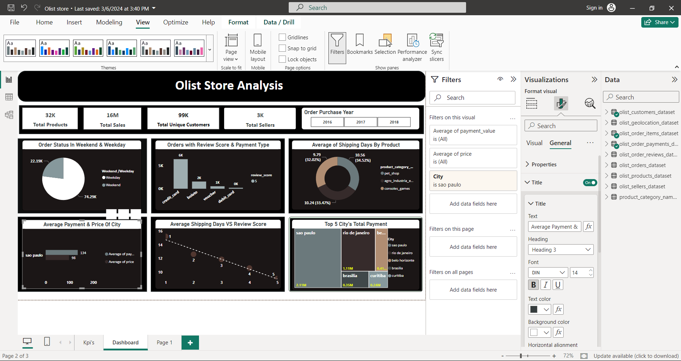
KPI4:Average Payment & Price Of City
Average price and payment values from customers of sao paulo city
The analysis of average price and payment values from customers of Sao Paulo city helps in understanding the spending patterns of customers in this region. It also helps Olist in identifying high-value customers and creating targeted marketing campaigns.

Slide 9
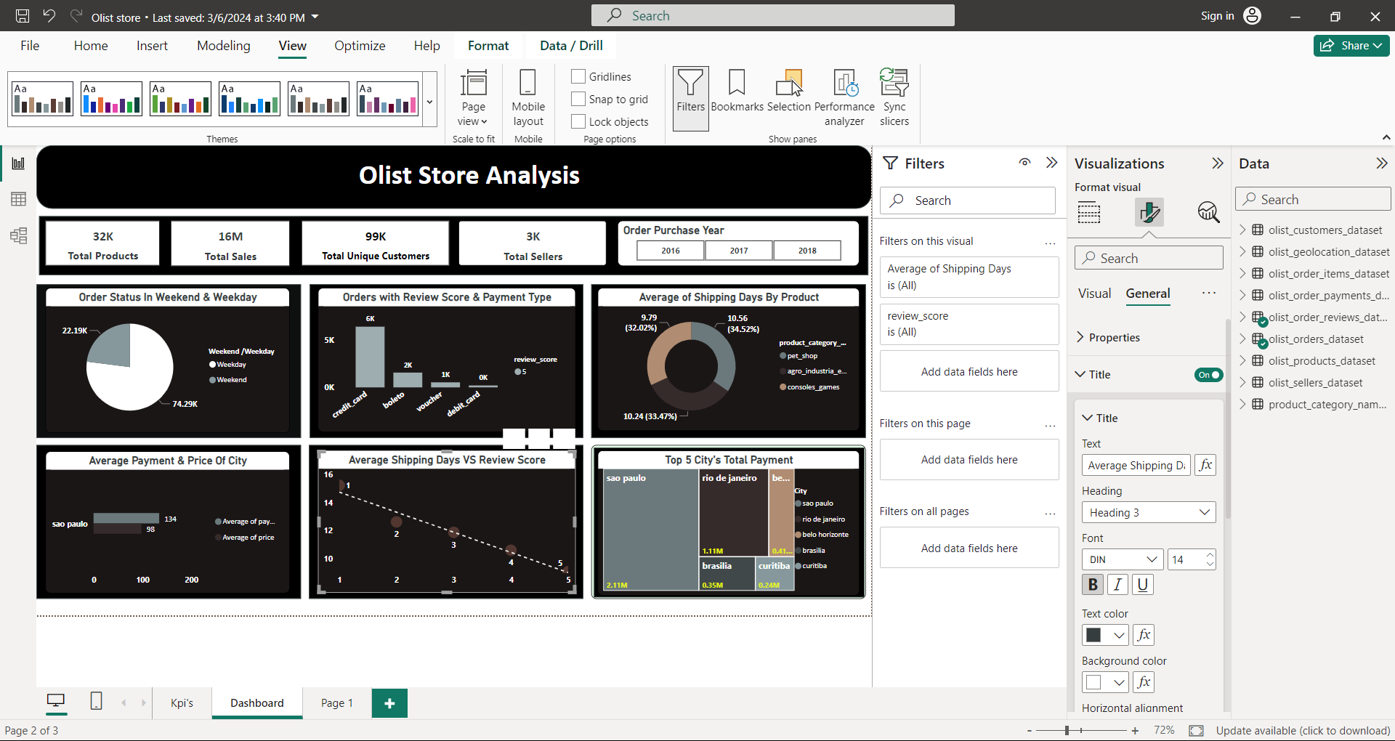
KPI5:Average Shipping Days VS Review Score
Relationship between shipping days (order_delivered_customer_date - order_purchase_timestamp) Vs review scores
This KPI analyzes the relationship between shipping days and review scores. It helps in understanding the impact of delivery time on customer satisfaction levels. Olist can use this information to optimize their logistics and improve their delivery time.

Slide 10
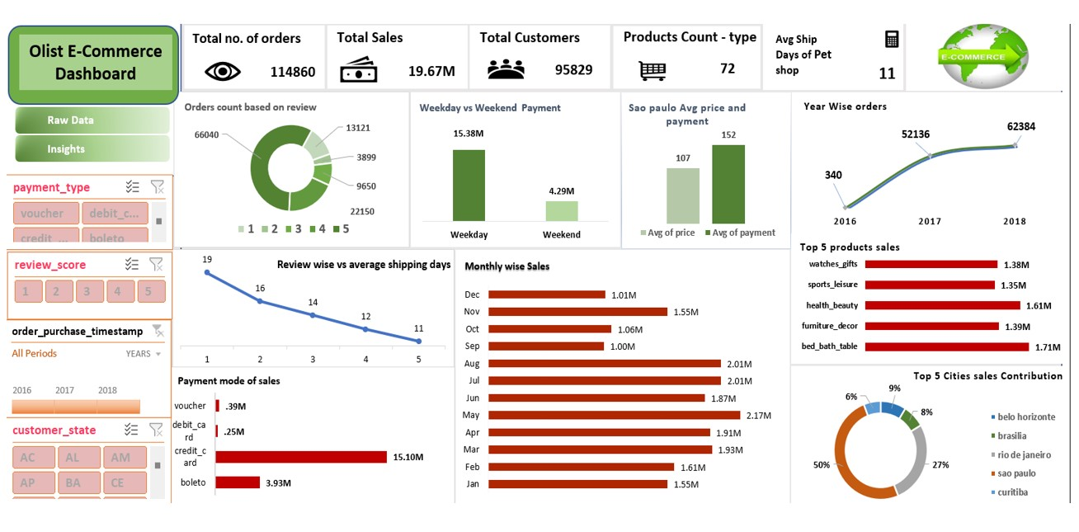
EXCEL Dashboard

Slide 11
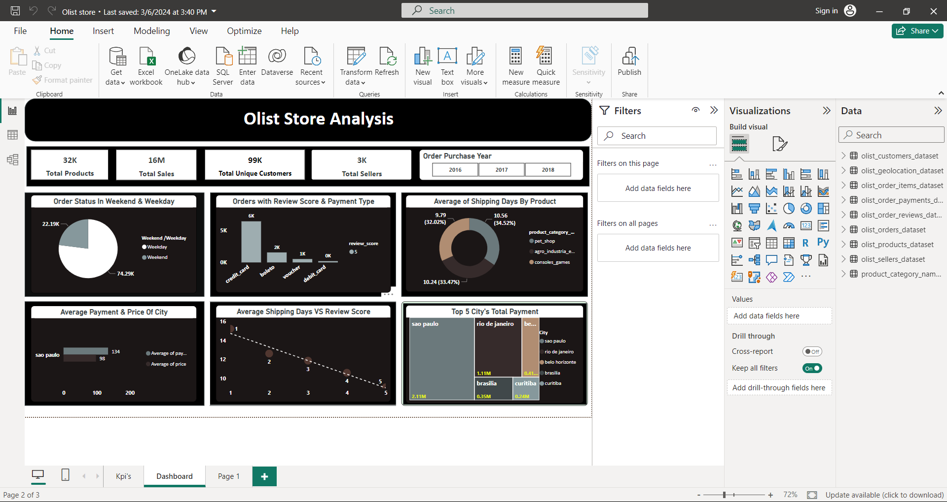
PowerBi Dashboard

Slide 12
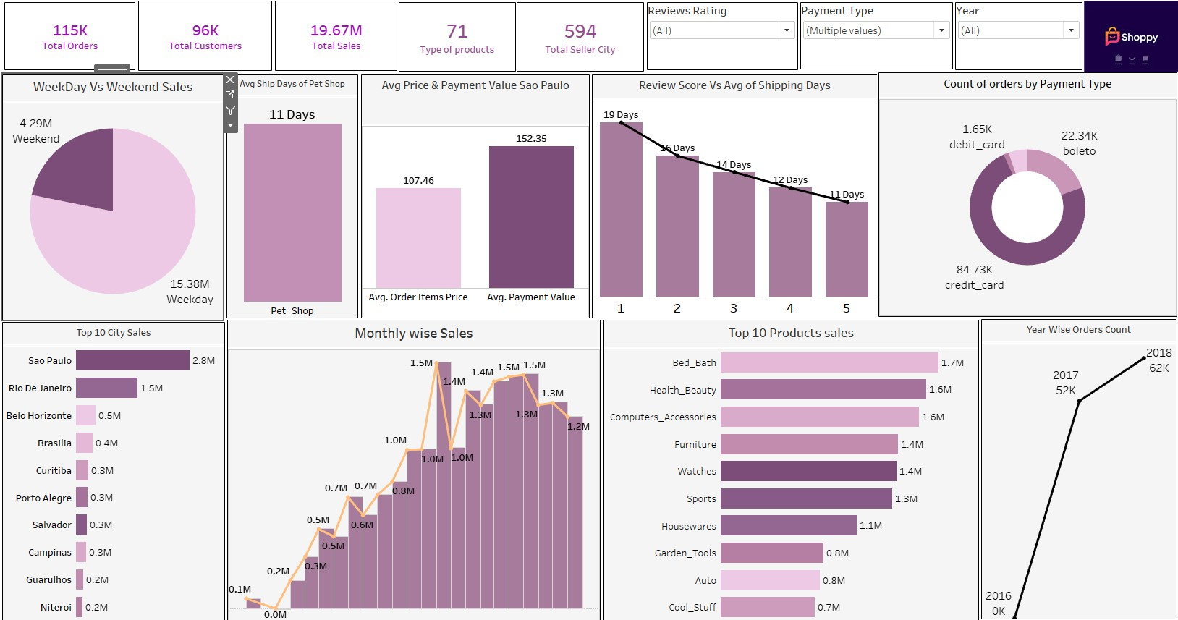
Tableau Dashboard

Slide 13
Insights
According to the data, Olist E-commerce has about 99,440 orders.
With about 89,940 orders being delivered, the company has a 90% delivery success rate.
Their average product rating is 4.09 stars, with product categories going as high as 4.67 stars and as low as 2.5 stars. 1 Star reviews are on third place in the review score distribution ranking which likely indicates that there could be problems with product quality in some product categories.
Delivery performance could also influence review scores and success rate could certainly be improved.

Slide 14
Recommendation
Regularly monitor and analyze customer reviews to gain insights in product quality and identify areas for improvement. Dashboards can be used to identify patterns in customer reviews.
This will provide a data-driven approach to enhance customer experience.
Investigate delivery delays and undelivered orders. Analyzing geographic locations could bring insights about certain challenges with demographics, accessibility, and possible route optimization.

Slide 15
Summary
Overall, regular monitoring of customer reviews, real- time tracking of fleet performance, together with proper shipment tracking and communication system can improve Olist's delivery and supply chain performance and ensure customers are highly satisfied with the service.

Slide 16
Conclusion
The Olist Store Analysis project provides valuable insights into customer behavior and payment statistics. The analysis of these KPIs helps Olist in identifying areas of improvement and creating targeted marketing campaigns.
As a data analyst, we used Excel and Power BI to clean and manipulate the dataset and create meaningful visualizations. This project serves as a great example of how data analysis can help businesses make informed decisions.

Slide 17
Thank you !

